Slide 1

Introduction to Python (week 5)
Louis Rey
UCSD Extension

Slide 2
Week 5 Objectives
Lambda Function
Object Oriented Programming (OOP)
Class Constructor
Inheritance
Class Methods
Overloading
Regular Expressions

Slide 3
Alternative Function Statement

Slide 4
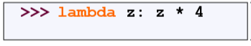
Lambda Notation
• Functions can be defined without giving them names (anonymous).
• This is most useful when passing a short function as an argument to
another function.
• The first argument to applier() is an unnamed function that takes one
input and returns the input multiplied by four.
• Note: only single-expression functions can be defined using this lambda
notation.

Slide 5
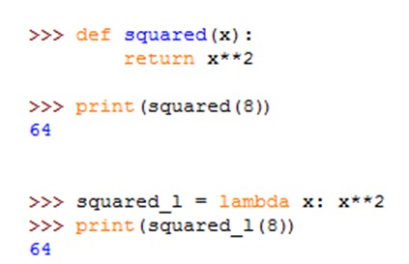
Lambda Functions
The lambda notation does not include a "return" statement -- it always contains an expression which is returned.

Slide 6
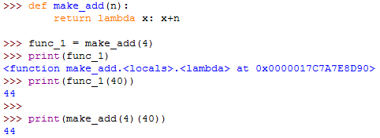
Lambda Functions
This example creates an anonymous function on the fly and returns it

Slide 7
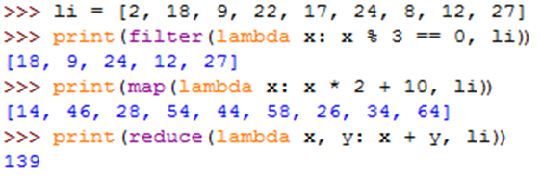
Lambda Functions
Example of an anonymous function in conjunction with standard functions: filter(), map() and reduce()
filter() calls our lambda function for each element of the list, and returns a new list that contains only those elements for which the function returned "True".
map() is used to convert to a new list using values from the lambda function.
The reduce() function calls the lambda function n-1 times if the list contains n elements.

Slide 8
Object Oriented Programming

Slide 9
Object Oriented Programming
Object-oriented programming (OOP)
Method of structuring a program by bundling related properties and behaviors into individual objects

Slide 10
Object Oriented Programming
Class − A user-defined prototype for an object that defines a set of attributes that characterize any object of the class
The attributes are data members (class variables and instance variables) and methods, accessed via dot notation.
Class variable − A variable that is shared by all instances of a class defined within a class but outside any of the class's methods
Data member − A class variable or instance variable that holds data associated with a class and its objects
Function overloading − Assignment of more than one behavior to a particular function
Instance variable − A variable that is defined inside a method and belongs only to the current instance of a class

Slide 11
Object Oriented Programming
Inheritance − Transfers characteristics of a class to other classes that are derived from it
Instance − An individual object of a certain class
Instantiation − The creation of an instance of a class
Method − A special kind of function that is defined in a class definition
Object − A unique instance of a data structure that's defined by its class. An object comprises both data members (class variables and instance variables) and methods
Operator overloading − The assignment of more than one function to a particular operator.

Slide 12
Class Constructors

Slide 13
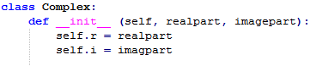
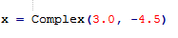
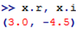
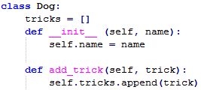
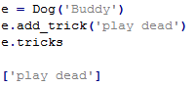
The Constructor
A constructor will set the object to an initial state when an object is first created
Class and Instance Variables

Slide 14
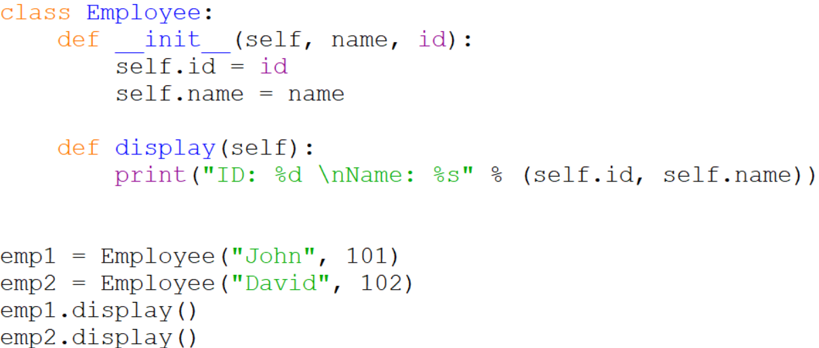
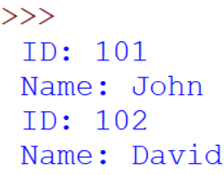
The Constructor

Slide 15
Inheritance

Slide 16
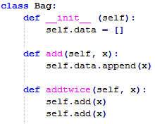
Methods may call other methods by using method attributes of the self argument
Inheritance
class DerivedClassName(BaseClassName):
<statement-1>
.
.
.
<statement-N>

Slide 17
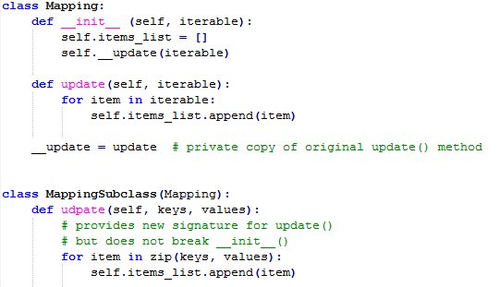
Inheritance

Slide 18
Standard Python Class Methods
__init__: gets called when a new instance of the class is created.
__del__: is called when an instance is about to be destroyed, which lets you do any clean-up e.g. closing file handles or database connections
__repr__ and __str__: Both return a string representation of the object, but __repr__ should return a Python expression that can be used to re-create the object. The more commonly used one is __str__, which can return anything.
__cmp__: Called to compare the object with another object. Note that this is only used with Python 2.x.
__lt__, __le__, __eq__, __ne__, __gt__ and __ge__: Called to compare the object with another object. These will be called if defined, otherwise Python will fall-back to using __cmp__.
__hash__: Called to calculate a hash for the object, which is used for placing objects in data structures such as sets and dictionaries.
__call__: Lets an object be "called" e.g. so that you can write things like this: obj(arg1,arg2,...).

Slide 19
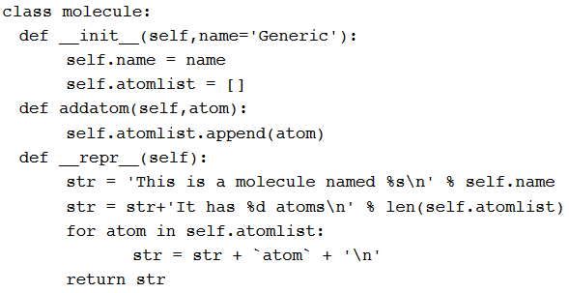
Module Class

Slide 20
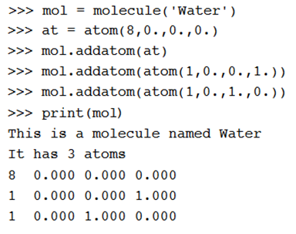
Using Module Class
• Note that the print function calls the atoms print function
• Code reuse: only have to type the code that prints an atom once; this means that if you change the atom specification, you only have one place to update.

Slide 21
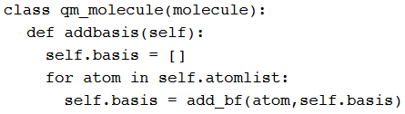
Inheritance
• __init__, __repr__, and __addatom__ are taken from the parent
class (molecule)
• Added a new function addbasis() to add a basis set
• Another example of code reuse
• Basic functions don't have to be retyped, just inherited
• Less to rewrite when specifications change

Slide 22
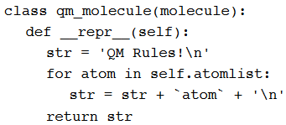
Overloading
• Now we only inherit __init__ and addatom from the parent
•We define a new version of __repr__ specially for QM

Slide 23
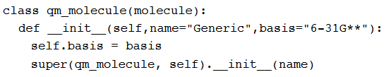
Adding to Parent Functions
• Sometimes you want to extend, rather than replace, the parent
functions.

Slide 24
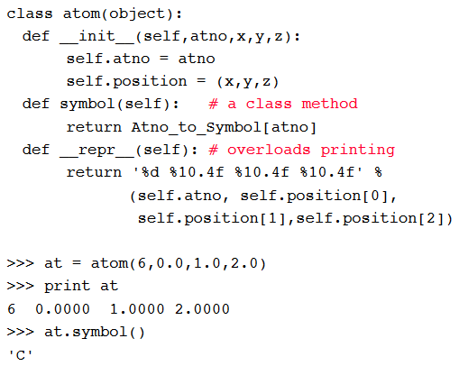
Example

Slide 25
Atom Class
• Overloaded the default constructor
• Defined class variables (atno, position) that are persistent and local to
the atom object
• Good way to manage shared memory:
• instead of passing long lists of arguments, encapsulate some of this data into an object, and pass the object.
• much cleaner programs result
• Overloaded the print operator
• We now want to use the atom class to build molecules...

Slide 26
Regular Expressions

Slide 27
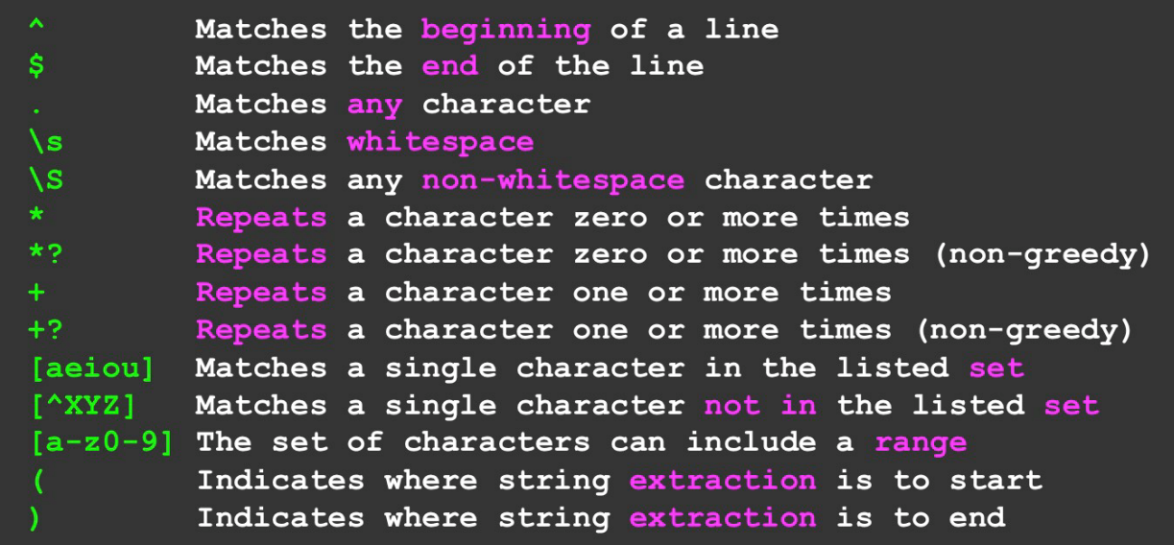
Common Regular Expressions

Slide 28
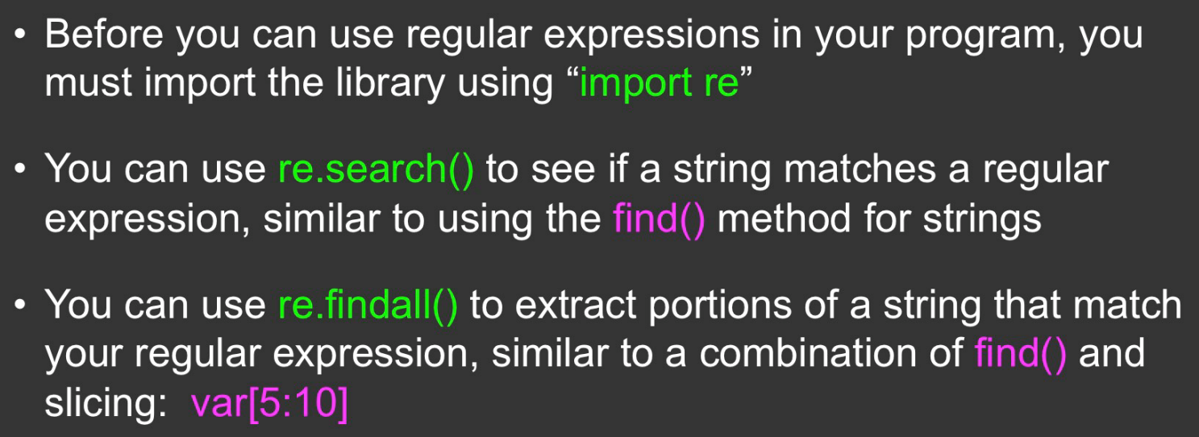

Slide 29
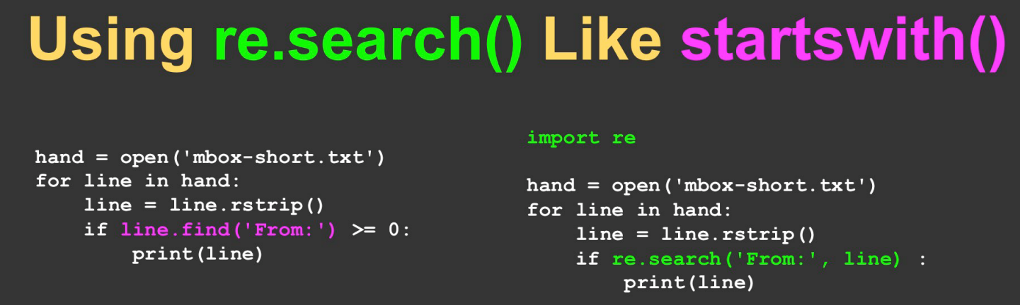

Slide 30
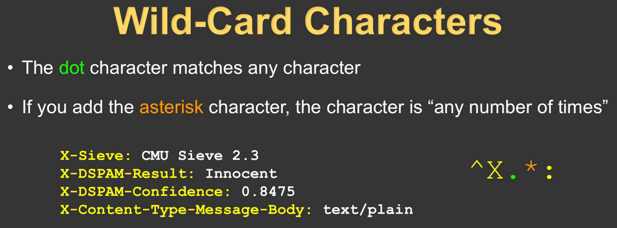
The asterisk actually represents zero or more

Slide 31
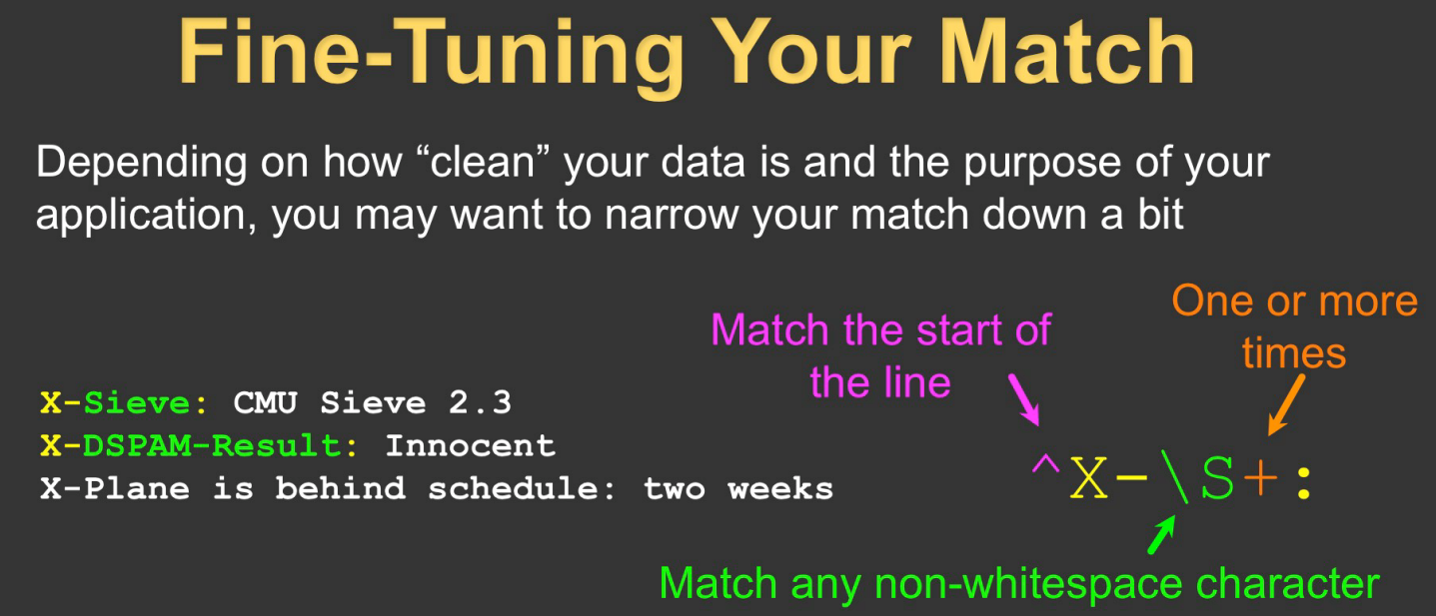
The plus symbol actually represents one or more

Slide 32
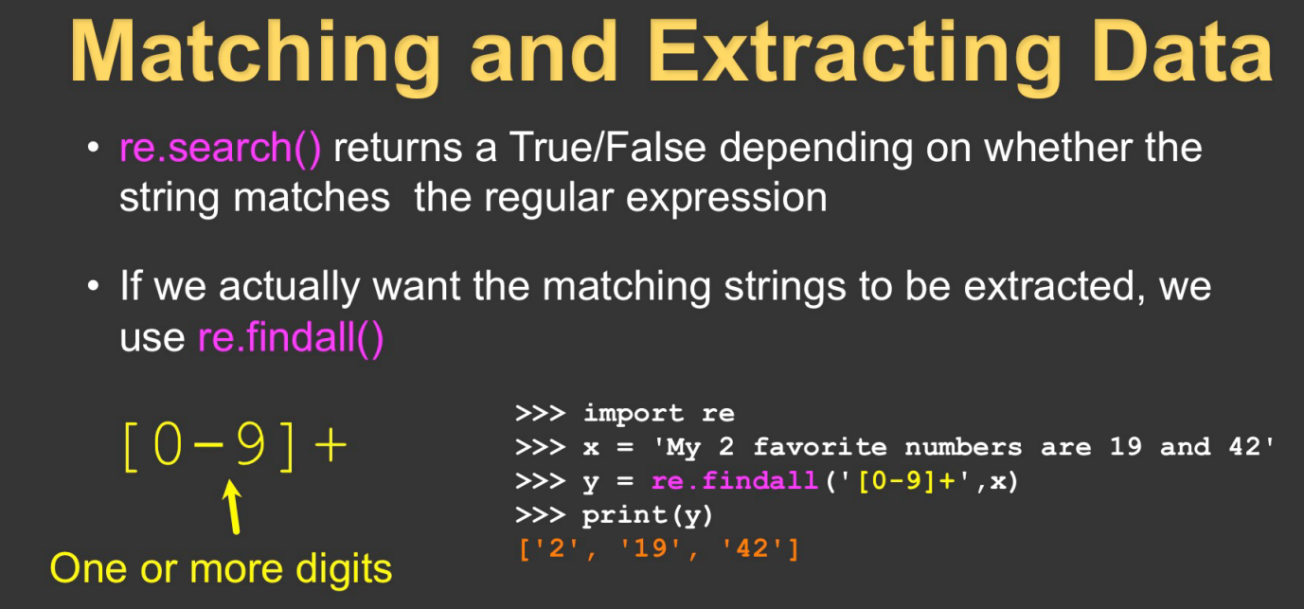
Use [0 – 9.] for numbers with decimal points

Slide 33
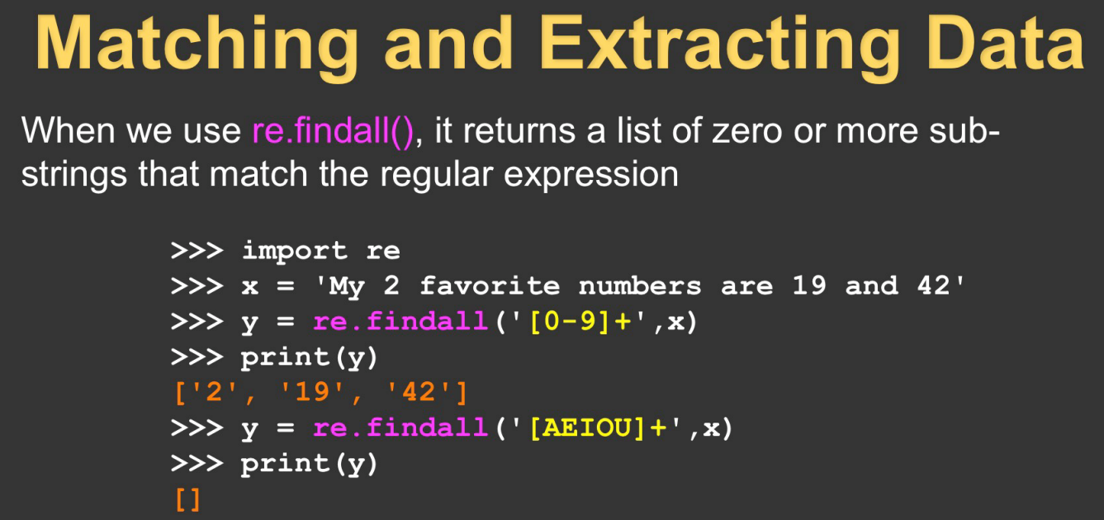

Slide 34
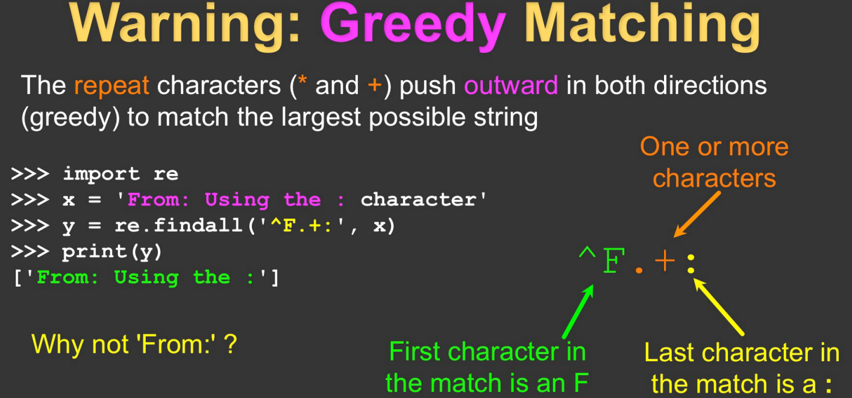

Slide 35
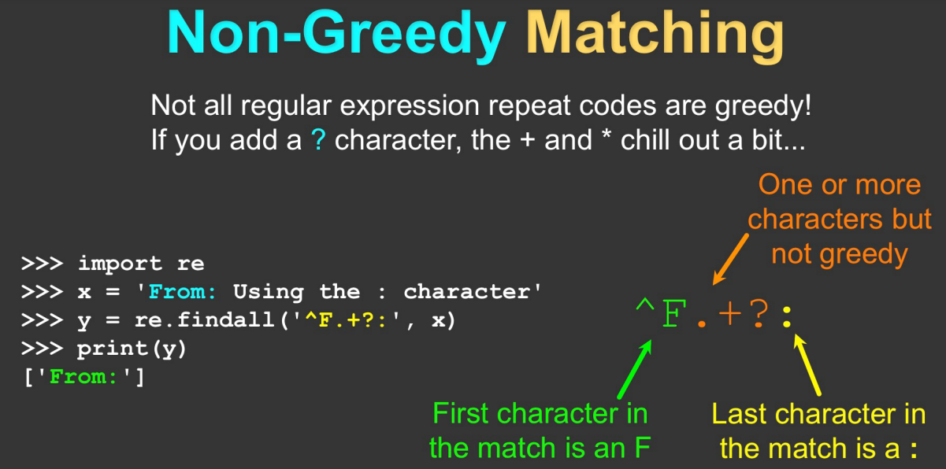

Slide 36
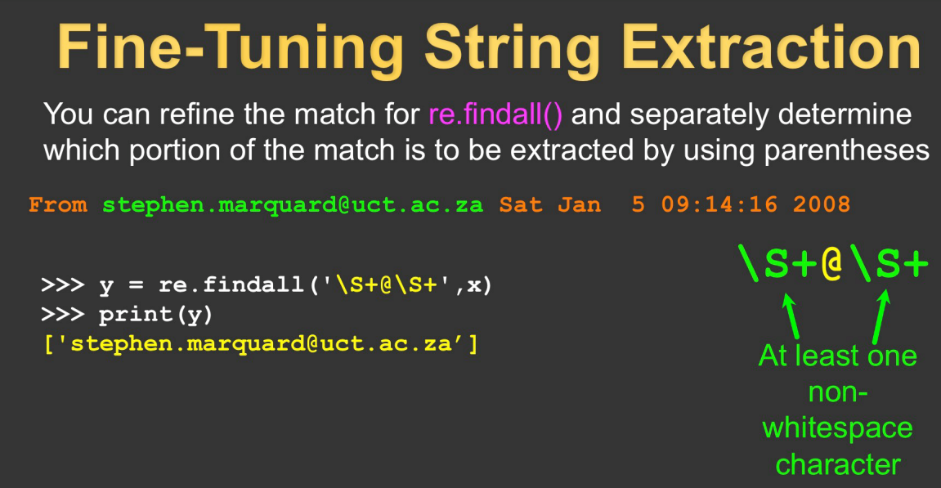

Slide 37
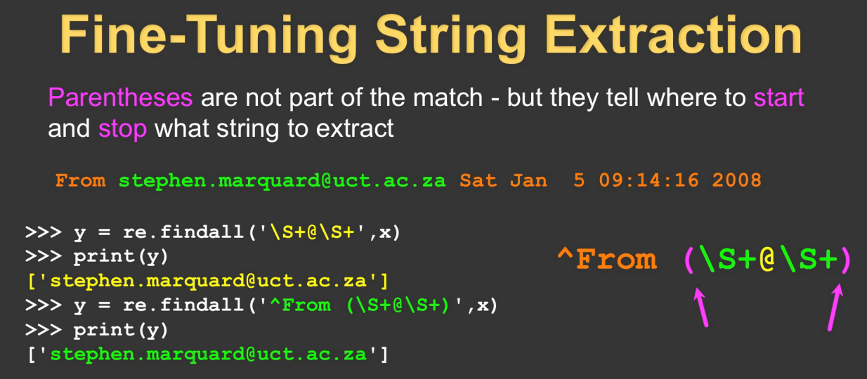
An exact match is requested but only the content in the parenthesis is returned.

Slide 38
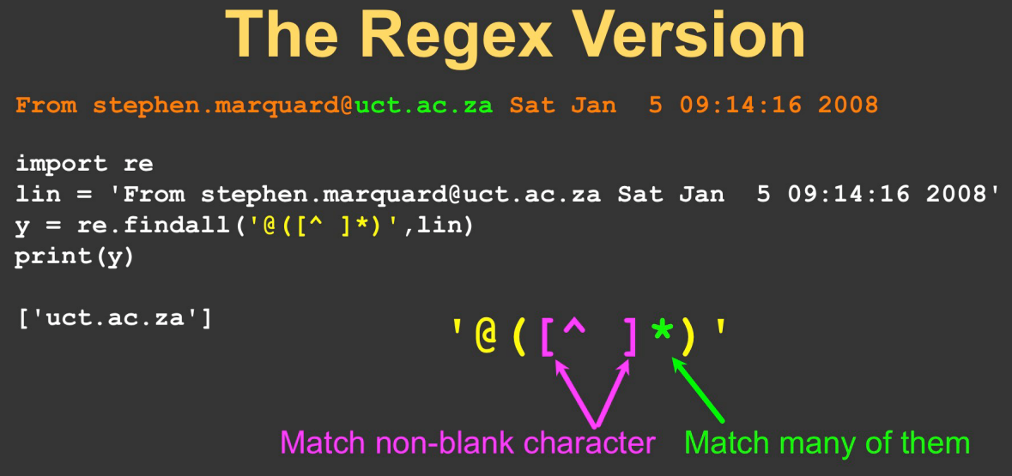

Slide 39
Resources
Matt Huenerfauth (Penn State)
Guido van Rossum (Google)
Richard P. Muller (Caltech)
Bill Boyd (Weslayan University)
Smithsonian Telescope Data Center
Programming Python, Mark Lutz
Fundamentals of Python, Kenneth Lamber
python.org/tutorials
Slides 27-38 Severance, Charles. Regular
Expressions, https://www.py4e.com/lessons/regex

